Slide 1

Engineering
Unit-I
Lecture-1
LINUX UTILITES
NAME : P. Mahesh Kumar
Assistant Professor
Faculty of Information Technology
SNIST

Slide 2
Introduction
1.Introduction
1.1 History of UNIX
UNIX is an Operating System (OS).
UNIX was developed about 50 years ago i.e., 1969 at AT NT& Bell Labs by Ken Thompson and Dennis Ritchie.
It is a Command Line Interpreter.
It was developed for the Mini-Computers as a time sharing system.
UNIX was the predecessor of LINUX.
1.2 History of LINUX
LINUX was created by Linus Torvalds in 1991.
LINUX is a open source.
LINUX is a variant of UNIX.

Slide 3
Introduction
1.3 Why LINUX/UNIX?
LINUX is free.
Can view and edit the source code of OS
It is fully customizable.
Most Important Feature is Stability
Important in shared environments and critical applications
LINUX has better security structure.
High Portability
Easy to port new H/W Platform
Written in C which is highly portable

Slide 4
File Handling Utilities
File handling Utilities can be classified in to following categories They are ,
File creating and deleting
File naming or renaming
Editing files
File access permissions
1) File creating and deleting
Commands for creating and deleting the files are cat and rm respectively.
Creating: $ cat > file1
Enter your text
Ctrl+d
The file1 has been created

Slide 5
File Handling Utilities
Deleting:$ rm file1
The file1 has been deleted
2) File naming or renaming
Unix support following command for renaming the file as,
$ mv file1 newfile
file1 renamed as newfile
3) Editing files
Unix operating system allows the user to edit a file, with the help of vi editor. The user can append the data, update the existing data by using different commands of vi editor.
old file:$ vi f1.txt (edit the file)
kljdf jfd
Kjgf jhkfg
Newfile:$ cat f1.txt (appending new line)
kljdf jfd
Kjgf jhkfg
Hipo;iopte
4) File access permissions
Unix operating system supports three types of users. They are,

Slide 6
File Handling Utilities
Owner ii)Group iii) others
Unix file system has three different file access permissions. They are,
Read ii) Write iii) Execute
The combination of file access permissions can be applied on above users by using chmod command
Syntax: $chmod a + rwx newfile
The new file can be accessed by any user. These file access permissions provides security for user files. In file maintaining system owner is the super user, so he can restrict other users from accessing the files.
Notes:
Also different volumes can be used by different users at the same time.

Slide 7
Commands
ln COMMAND:
ln command is used to create link to a file (or) directory.
SYNTAX: ln [options] existingfile(or directory)name Linkfile(or directory)
OPTIONS:
1. Soft Link(symbolic)
2. Hard Link
1. SOFT link: it is coated by using –s option. It represents logical file some where else in the system.
Syntax: ln -s [original filename] [link name]
EXAMPLE:
ln -s file1.txt file2.txt
Creates a symbolic link to 'file1.txt' with the name of 'file2.txt'. Here inode for 'file1.txt' and 'file2.txt' will be different.

Slide 8
Commands
1. HARD link: Each hard linked file is assigned the same Inode value as the original, therefore they reference the same physical file location. Hard links more flexible and remain linked even if the original or linked files are moved throughout the file system
Syntax: ln [original filename] [link name]
EXAMPLE:
ln file3.txt file4.txt
For example, if we have a file a.txt. If we create a hard link to the file and then delete the file, we can still access the file using hard link. But if we create a soft link of the file and then delete the file, we can’t access the file through soft link and soft link becomes dangling. Basically hard link increases reference count of a location while soft links work as a shortcut (like in Windows)

Slide 9
Commands
mv COMMAND:
mv command which is short for move. It is used to move/rename file from one directory to another. mv command is different from cp command as it completely removes the file from the source and moves to the directory specified, where cp command just copies the content from one file to another.
SYNTAX: $mv [-f] [-i] oldname newname
OPTIONS:
-f This will not prompt before overwriting (equivalent to --reply=yes). mv -f will move the file(s) without prompting even if it is writing over an existing target.
-I Prompts before overwriting another file.

Slide 10
Commands
EXAMPLE:
To Rename / Move a file:
mv file1.txt file2.txt
This command renames file1.txt as file2.txt
2. To move a directory
mv hscripts tmp
In the above line mv command moves all the files, directories and sub-directories from hscripts folder/directory to tmp directory if the tmp directory already exists. If there is no tmp directory it rename's the hscripts directory as tmp directory.
3. To Move multiple files/More files into another directory
mv file1.txt tmp/file2.txt newdir
This command moves the files file1.txt from the current directory and file2.txt from the tmp folder/directory to newdir.

Slide 11
Commands
rm COMMAND:
rm linux command is used to remove/delete the file from the directory.
SYNTAX: $rm [options..] [file | directory]
OPTIONS:
-f Remove all files in a directory without prompting the user.
-I Interactive. With this option, rm prompts for confirmation before removing any files.
-r (or) –R Recursively remove directories and subdirectories in the argument list. The directory will be emptied of files and removed. The user is normally prompted for removal of any write-protected files which the directory contains.
EXAMPLE: 1) To Remove / Delete a file:
rm file1.txt
Here rm command will remove/delete the file file1.txt.

Slide 12
Commands
2. To delete a directory tree:
rm -ir tmp
This rm command recursively removes the contents of all subdirectories of the tmp directory, prompting you regarding the removal of each file, and then removes the tmp directory itself.
3. To remove more files at once
rm file1.txt file2.txt
rm command removes file1.txt and file2.txt files at the same time.

Slide 13
Commands
mkdir COMMAND:
mkdir command is used to create one or more directories.
SYNTAX: mkdir [options] directories
OPTIONS:
-m Set the access mode for the new directories.
-p Create intervening parent directories if they don't exist.
-v Print help message for each directory created.
EXAMPLE:
Create directory:
mkdir test
The above command is used to create the directory 'test'.
2. Create directory and set permissions:
mkdir -m 666 test
The above command is used to create the directory 'test' and set the read and write permission.

Slide 14
Commands
rmdir COMMAND:
rmdir command is used to delete/remove a directory and its subdirectories.
SYNTAX: The Syntax is rmdir [options..] Directory OPTIONS: -p Allow users to remove the directory dirname and its parent directories which become empty.
EXAMPLE:
1. To delete/remove a directory
rmdir tmp
rmdir command will remove/delete the directory tmp if the directory is empty.
2. To delete a directory tree:
rm -ir tmp
This command recursively removes the contents of all subdirectories of the tmp directory, prompting you regarding the removal of each file, and then removes the tmp directory itself.

Slide 15
Commands
cp COMMAND:
cp command copy files from one location to another. If the destination is an existing file, then the file is overwritten; if the destination is an existing directory, the file is copied into the directory (the directory is not overwritten). SYNTAX: $cp [OPTIONS]... SOURCE DEST
cp [OPTIONS]... SOURCE... DIRECTORY
cp [OPTIONS]... --target-directory=DIRECTORY SOURCE...
OPTIONS:
--a same as -dpR.
--backup[=CONTROL] make a backup of each existing destination file
-b like --backup but does not accept an argument.
-f if an existing destination file cannot be opened, remove it and try

Slide 16
Commands
Example4:Search for a file name test.txt and its permissions are 775 in a given box
find / -perm 775 –name test.txt
Example5: How about searcing files with SUID bit set and file permissions are 755?
find / -perm 4755
Example6: Search for all the files with name test.txt and the owner of this file is amar
find / -user Surendra –name test.txt
Example7: find all the files whos name is test.txt and owned by a group called redcluster
find / -group redcluster –name test.txt

Slide 17
Commands
Pwd COMMAND:
Short for print working directory the pwd command displays the name of the current working directory.
Syntax
pwd
Examples
pwd
Typing pwd at the prompt would give you something similar to:
/home/computerhope/public_html

Slide 18
Security by file permissions
File ownership is an important component of UNIX that provides a secure method for storing files. Every file in UNIX has the following attributes:
Owner permissions: The owner's permissions determine what actions the owner of the file can perform on the file.
Group permissions: The group's permissions determine what actions a user, who is a member of the group that a file belongs to, can perform on the file.
Other (world) permissions: The permissions for others indicate what action all other users can perform on the file.
The Permission Indicators:
While using ls -l command it displays various information related to file permission as follows:
$ls -l -rwxr-xr-- 1 root users 1024 Nov 2 00:10 myfile
drwxr-xr--- 1 root users 1024 Nov 2 00:10 mydir
Here first column represents different access mode ie. permission associated with a file or directory.
18

Slide 19
Security by file permissions
File Access Modes:
The permissions of a file are the first line of defense in the security of a Unix system. The basic building blocks of Unix permissions are the read, write, and execute permissions, which are described below:
Read: Grants the capability to read ie. view the contents of the file.
Write: Grants the capability to modify, or remove the content of the file.
Execute: User with execute permissions can run a file as a program
Changing Permissions:
To change file or directory permissions, you use the chmod (change mode) command. There are two ways to use chmod: symbolic mode and absolute mode.
Using chmod in Symbolic Mode:
The easiest way for a beginner to modify file or directory permissions is to use the symbolic mode. With symbolic permissions you can add, delete, or specify the permission set you want by using the operators in the following table.

Slide 20
Security by file permissions
Chmod operator Description
+ Adds the designated permission(s) to a file or directory.
- Removes the designated permission(s) from a file or directory.
= Sets the designated permission(s).
Here's an example using testfile. Running ls -1 on testfile shows that the file's permissions are as follows:
$ls -l testfile-rwxrwxr-- 1 amrood users 1024 Nov 2 00:10 testfile Then each example chmod command from the preceding table is run on testfile, followed by ls -l so you can see the permission changes:

Slide 21
Security by file permissions
$chmod o+wx testfile
$ls -l testfile
-rwxrwxrwx 1 root users 1024 Nov 2 00:10 testfile
$chmod u-x testfile
$ls -l testfile
-rw-rwxrwx 1 root users 1024 Nov 2 00:10 testfile
$chmod g=r-x testfile
$ls -l testfile
-rw-r-xrwx 1 root users 1024 Nov 2 00:10 testfile

Slide 22
Security by file permissions
Here's how you could combine these commands on a single line:
$chmod o+wx,u-x,g=r-x testfile
$ls -l testfile
-rw-r-xrwx 1 root users 1024 Nov 2 00:10 testfile
Using chmod with Absolute Permissions:
The second way to modify permissions with the chmod command is to use a number to specify each set of permissions for the file.
Each permission is assigned a value, as the following table shows, and the total of each set of permissions provides a number for that set.

Slide 23
Security by file permissions
Number Octal Permission Representation Ref
0 No permission ---
1 Execute permission --x
2 Write permission -w-
3 Execute and write permission: 1 (execute) + 2 (write) = 3 -wx
4 Read permission r--
5 Read and execute permission: 4 (read) + 1 (execute) = 5 r-x
6 Read and write permission: 4 (read) + 2 (write) = 6 rw-
All permissions: 4 (read) + 2 (write) + 1 (execute) = 7 rwx

Slide 24
Security by file permissions
Here's an example using testfile. Running ls -1 on testfile shows that the file's permissions are as follows:
$ls -l testfile
-rwxrwxr-- 1 root users 1024 Nov 2 00:10 testfile
Then each example chmod command from the preceding table is run on testfile, followed by ls -l so you can see the permission changes:
$ chmod 755 testfile
$ls -l testfile
-rwxr-xr-x 1 root users 1024 Nov 2 00:10 testfile
$chmod 743 testfile
$ls -l testfile
-rwxr---wx 1 root users 1024 Nov 2 00:10 testfile
$chmod 043 testfile

Slide 25
Security by file permissions
Changing Owners and Groups:
While creating an account on Unix, it assigns a owner ID and a group ID to each user. All the permissions mentioned above are also assigned based on Owner and Groups.
Two commands are available to change the owner and the group of files:
chown: The chown command stands for "change owner" and is used to change the owner of a file.
chgrp: The chgrp command stands for "change group" and is used to change the group of file.
Changing Ownership:
The chown command changes the ownership of a file. The basic syntax is as follows:
$ chown user filelist
The value of user can be either the name of a user on the system or the user id (uid) of a user on the system.
Following example:
$ chown root1 testfile
Changes the owner of the given file to the user root1
NOTE: The super user, root, has the unrestricted capability to change the ownership of a any file but normal users can change only the owner of files they own.

Slide 26
Security by file permissions
Changing Group Ownership:
The chrgp command changes the group ownership of a file. The basic syntax is as follows:
$ chgrp group filelist The value of group can be the name of a group on the system or the group ID (GID) of a group on the system.
Following example:
$ chgrp special testfile
Changes the group of the given file to special group.

Slide 27
Process utilities
ps COMMAND:
ps command is used to report the process status. ps is the short name for Process Status.
SYNTAX: The Syntax is ps [options]
OPTIONS:
-e List information about every process now running.
-f Generates a full listing.
–u option followed by user-id displays the processes owned by the user-id.
-l Generate a long listing.

Slide 28
Process utilities
EXAMPLE:
1. ps
Output:
PID TTY TIME CMD
2540 pts/1 00:00:00 bash
2621 pts/1 00:00:00 ps
In the above example, typing ps alone would list the current running processes.
2. ps -f
Output:
UID PID PPID C STIME TTY TIME CMD
abc 2540 2536 0 15:31 pts/1 00:00:00 bash
xyz 2639 2540 0 15:51 pts/1 00:00:00
ps -f
Displays full information about currently running processes.

Slide 29
Process utilities
who COMMAND:
who command can list the names of users currently logged in, their terminal, the time they have been logged in, and the name of the host from which they have logged in.
SYNTAX: who [options] [file]
OPTIONS:
-H Print column headings above the output.
-u provides a detailed list
EXAMPLE:
who -uH
Output:
NAME LINE TIME IDLE PID COMMENT
hiox ttyp3 Jul 10 11:08 . 4578
This sample output was produced at 11 a.m. The "." indicates activity within the last minute.

Slide 30
Process utilities
2. $who am i
who am i command prints the user name.
w command:
w - show who is logged on and what they are doing
DESCRIPTION
w displays information about the users currently on the machine, and their processes. The header shows, in this order, the current time, how long the system has been running, how many users are currently logged on, and the system load averages for the past 1, 5, and 15 minutes.
Kill COMMAND:
Kill command in UNIX and Linux is normally used to kill a suspended or hanged process or process group. Example:
“if you issue the ps command and find that one of your processes is hung or if you started a large job that you wish to stop, you can do so with the kill command”

Slide 31
Process utilities
The following example shows how to kill a process,
$ps –ef | grep sales
Sales 19336 19334 0 05:24:32 pts/4 0:01 -ksh
Sales 19426 19336 0 06:01:01 pts/4 0:00 ora
Kill 19426 This will kill the process ora with PID 19426
To terminate more than one process at a time, use the following syntax
$kill signal PID PID PID
$pkill signal process process process
In kill utility we will give PID where as in pkill utility we have to give the name of the process
kill -9 is used to forcefully terminate a process in Unix. Here is syntax of kill command in UNIX.
ps -ef| grep process_identifier // will give you PID
kill -9 PID

Slide 32
Disk utilities
The utilities which will display the information about the disk is known as the disk utilities.
The following mentioned are the disk utilities
which are used in common,
df
du
df COMMAND:
df command is used to find the empty disk space. Df stands for disk free.
Example:
$ df
Filesystem 1K-blocks Used Available Use% Mounted on
/dev/sda1 132239776 6210884 119311504 5% /
/tmpfs 4021876 0 4021876 0% /dev/shm
/dev/sdb2 30969600 117740 29278696 1% /home/oracle
/dev/sdc1 576310180 71232 546964104 1% /home/data
Du COMMAND:
The du command displays the disk space used by the specified files and directories.

Slide 33
Disk utilities
Syntax:
du [option]….[file]
Options:
–a: it writes counts for all files, not just for directories .
-b: it prints the size in bytes.
-c: it prints the grand total (i.e, the total disk space used by the directory).
-h: it prints the human readable formats.example1k,2g
-s: it does not show the size of sub-directories.
[amar@localhost ~]$ du -a
8 ./.zshrc
8 ./f1
8 ./.bashrc
8 ./.kde/Autostart/.directory
16 ./.kde/Autostart
24 ./.kdehst

Slide 34
Networking commands
The commands which we will use for the communication between more than
one system for sharing resources or any other issue are known as the
networking commands.
Commands such as telnet, ftp, rlogin, finger are commonly used networking
commands.
telnet COMMAND:
telnet is a internet protocol which enables user to connect a remote system and
transfer data.
Syntax: $ telnet hostname or telnet ip_address
Example : $ telnet itctnss0123
Trying 164.130….
Connected to itctnss0123.
Escape character is ‘^]’.
SunOS 5.8
login: root
Password:
Last login: Thu Feb 24 16:13:12 from itctnss0123
Sun Microsystems Inc. SunOS 5.8 Generic Patch February 2004

Slide 35
Networking commands
Finger COMMAND:
The finger command is used to find out the details of a user, on both local and remote system.
Finger may be disabled on other systems for security reasons.
Following are the simple syntax to use finger command:
Check all the logged in users on local machine as follows:
Examples:
[amar@localhost ~]$ finger
Login Name Tty Idle Login Time Office Office Phone
amar pts/1 May 25 10:06 (172.16.10.5)
root root pts/0 7d May 16 14:03 (:0.0)
[amar@localhost ~]$ finger amar
Login: amar Name: (null)
Directory: /home/amar Shell: /bin/bash
On since Sat May 25 10:06 (IST) on pts/1 from 172.16.10.5
No mail.
No Plan.

Slide 36
Networking commands
Ftp is the user interface to the Internet standard File Transfer Protocol. The
program allows a user to transfer files to and from a remote network site.
This utility helps you to upload and download your file from one computer to
another computer.
The ftp utility has its own set of UNIX like commands which allow you to
perform tasks such as:
Connect and login to a remote host.
Navigate directories.
List directory contents
Put and get files
Transfer files as ascii, ebcdic or binary
Syntax:
Following is the simple syntax to use ping command:
$ftp hostname or ip-address

Slide 37
Networking commands
[amar@localhost ~]$ ftp amar
ftp: amar: unknown host
ftp> quit
[amar@localhost ~]$ ftp 172.16.1.254
ftp: connect: Connection refused
ftp>
ftp> quit
Command | Description
put filename | Upload filename from local machine to remote machine.
get filename | Download filename from remote machine to local machine.
mput file list | Upload more than one files from local machine to remove machine.
mget file list | Download more than one files from remote machine to local machine.
prompt off | Turns prompt off, by default you would be prompted to upload or download movies using mput or mget commands.
prompt on | Turns prompt on.
dir | List all the files available in the current directory of remote machine.
cd dirname | Change directory to dirname on remote machine.
lcd dirname | Change directory to dirname on local machine.
quit | Logout from the current login.

Slide 38
Networking commands
rlogin COMMAND:
rlogin command helps the user to log on to his identical remote account, with out using either the username or password.
The “rlogin” command is similar to telnet. The rlogin starts a terminal session on a remote host.
Syntax : $rlogin hostname
Example : 1) [amar@localhost ~]$ rlogin 172.16.1.254
connect to address 172.16.1.254 port 543: Connection refused
Trying krb4 rlogin...
connect to address 172.16.1.254 port 543: Connection refused
trying normal rlogin (/usr/bin/rlogin)
2) [amar@localhost ~]$ rlogin amar
amar: host unknown
Trying krb4 rlogin...
amar: host unknown
trying normal rlogin (/usr/bin/rlogin)
amar: Unknown host

Slide 39
Filters
a filter is a program that accepts input, transforms it and outputs the transformed data. The idea of the filter is closely associated with several ideas that are part of the UNIX operating system: standard input and output, input/output redirection and pipes.
Standard input and output refer to default locations from which a program will take input and to which it will write output. The standard input (STDIN) for a program running interactively at the command line is the keyboard; the standard output (STDOUT) is the terminal screen.
With input/output redirection, a program can take input or send output using a location other than standard input or output—a file, for example. Redirection of STDIN is accomplished using the < symbol, redirection of STDOUT by >.

Slide 40
Filters
cat COMMAND:
cat linux command concatenates files and print it on the standard output.
SYNTAX: $ cat [OPTIONS] [FILE]...
OPTIONS:
-A Show all.
-b Omits line numbers for blank space in the output.
-e A $ character will be printed at the end of each line prior to a new line.
-E Displays a $ (dollar sign) at the end of each line.
-n Line numbers for all the output lines.
-s If the output has multiple empty lines it replaces it with one empty line.
-T Displays the tab characters in the output.
-v Non-printing characters (with the exception of tabs, new-lines and form-feeds) are printed visibly.
Examples:
1. To Create a new file:
cat > file1.txt
This command creates a new file file1.txt. After typing into the file press control+d (^d) simultaneously to end the file.

Slide 41
Filters
2. To Append data into the file:
cat >> file1.txt
To append data into the same file use append operator >> to write into the file, else the file will be overwritten (i.e., all of its contents will be erased).
3. To display a file:
cat file1.txt
This command displays the data in the file.
4. To concatenate several files and display:
cat file1.txt file2.txt
The above cat command will concatenate the two files (file1.txt and file2.txt) and it will display the output in the screen. Some times the output may not fit the monitor screen. In such situation you can print those files in a new file or display the file using less command.
cat file1.txt file2.txt | less

Slide 42
Filters
5. To concatenate several files and to transfer the output to another file.
cat file1.txt file2.txt > file3.txt
In the above example the output is redirected to new file file3.txt. The cat
command will create new file file3.txt and store the concatenated output into
file3.txt.
Display beginning and end of files
head COMMAND:
head command is used to display the first ten lines of a file, and also specifies
how many lines to display
SYNTAX: $ head [options] filename

Slide 43
Filters
OPTIONS:
-n To specify how many lines you want to display.
-n number The number option-argument must be a decimal integer whose sign affects the location in the file, measured in lines.
-c number The number option-argument must be a decimal integer whose sign affects the location in the file, measured in bytes.
EXAMPLE:
head f1.txt
This command prints the first 10 lines of ' f1.txt '.
2. head -5 f1.txt
The head command displays the first 5 lines of ' f1.txt '.
3. head -c 5 f1.txt
The above command displays the first 5 characters of ' f1.txt '.
tail COMMAND:
Tail command is used to display the last or bottom part of the file. By default it displays last 10 lines of a file.
SYNTAX:
$ tail [options] filename

Slide 44
Filters
OPTIONS:
-l To specify the units of lines.
-b To specify the units of blocks.
-n To specify how many lines you want to display.
-c number The number option-argument must be a decimal integer whose sign affects the location in the file, measured in bytes.
-n number The number option-argument must be a decimal integer whose sign affects the location in the file, measured in lines.
EXAMPLE:
tail index.php
It displays the last 10 lines of 'index.php'.
2. tail -2 index.php
It displays the last 2 lines of 'index.php'.
3. tail -n 5 index.php
It displays the last 5 lines of 'index.php'.
4. tail -c 5 index.php
It displays the last 5 characters of 'index.php'.

Slide 45
Filters
cut COMMAND:
cut command is used to cut out selected fields of each line of a file. The cut command uses delimiters to determine where to split fields.
SYNTAX:
cut [options]
OPTIONS:
-c Specifies character positions.
-b Specifies byte positions.
-d flags Specifies the delimiters and fields.
EXAMPLE:
cut -c1-3 text.txt
Output:
Thi
Cut the first three letters from the above line.
2. cut -d, -f1,2 text.txt
Output:
This is, an example program
The above command is used to split the fields using delimiter and cut the first two fields.

Slide 46
Filters
paste COMMAND:
paste command is used to paste the content from one file to another file. It is also used to set column format for each line.
SYNTAX:
$ paste [options]
OPTIONS:
-s Paste one file at a time instead of in parallel.
-d Reuse characters from LIST instead of TABs .
EXAMPLE:
paste test.txt>test1.txt
Paste the content from 'test.txt' file to 'test1.txt' file.
2. ls | paste - - - -
List all files and directories in four columns for each line.
sort COMMAND:
sort command is used to sort the lines in a text file.
SYNTAX:
sort [options] filename
OPTIONS:
-r Sorts in reverse order.
-u If line is duplicated display only once.
-o filename Sends sorted output to a file.

Slide 47
Filters
EXAMPLE:
sort test.txt
Sorts the 'test.txt'file and prints result in the screen.
2. sort -r test.txt
Sorts the 'test.txt' file in reverse order and prints result in the screen
tr COMMAND:
tr filter translates specified characters into other characters.
Normal usage
tr string1 string2
• Translates any character read from stdin that is in string1 into the corresponding character from string2; otherwise the character is simply passed through.
• string1 and string2 normally have the same number of characters.
Eg tr abc X5Z
translates a into X, b into 5 and c into Z.

Slide 48
Filters
uniq COMMAND:
uniq assumes lines of ASCII file are sorted and deals with unique lines depending on the option given.
No option, one copy of each unique line is printed to stdout. Duplicated lines are discarded.
Eg uniq dups
dups: default output:
A a
b b
b c
c dd
dd ddd
ddd
ddd
Ddd
-u option prints only those lines that have no duplicates.
Eg uniq -u dups
dups: -u output:
a a
b c
b dd
c

Slide 49
Filters
-d option prints only those lines that have duplicates.
Eg uniq -d dups
dups: -d output:
a b
b ddd
b
c
dd
ddd
ddd
ddd
uniq runs as filter or as program driving a pipeline.
There are options to compare fields and to count duplicated lines.

Slide 50
Filters
Wc COMMAND:
The purpose of wc command is to count the number of lines,words,characters in a particular file or files
Syntax: $ wc filename
Example:
$ wc file1
40 200 file1
First column represents number of lines
Second column represents number of words
Third column represents number of characters
Fourth column shows the file name
OPTIONS:
-l (line)
-w (words)
-c (character)

Slide 51
Filters
cmp COMMAND:
Compares two files and tells you what line numbers are different.
By default location of first mismatch is displayed
Syntax: $ cmp [-options] filename1 filename2
-l this option displays the list of all differences present in the file byte- by-byte.
-s Write nothing for differing files; return exit status(‘0’ or ‘1’) only.
the ‘0’ specifies that two files are similar and ‘1’ specifies that there is at least one that is different.

Slide 52
Text processing utilities
The operations performed by the text processing utilities are as follows
Processing the text
Modifying the content of files
Deleting words and charlacters form files
cat: cat is used to create the files.
$cat> filename
Type some text here
Press ctrl+d
$
Cat can also be used to display the contents Of a file.
$cat filename
Cat can also concatenate the contents of 2 files and store them in third file.
Cat>file1 file2>new file
To append the contents of two files into another file use
Cat>file1 file2>>new file

Slide 53
Text processing utilities
tail:
tail command displays the end of the file. It displays the last ten lines by default.
$tail file
To display last 3 lines use
$tail –n 3 file or
$tail -3 file
We can also address the lines from the beginning of the file instead of the end.
The + count allows to do that.

Slide 54
Text processing utilities
head:
head command as the name implies, displays the top of the file. When used without an option, it displays the first 10 lines of the file.
$head file
We can use –n option to specify a line count and display, say first 3 lines of the file.
$head –n 3 file or $head -3 file
Sort:
Sort can be used for sorting the contents of a file.
$sort shortlist
Sorting starts with the first character of each line and proceeds to the next character only when the characters in two lines are identical.
Sort options:
With –t option sorts a file based on the fields.

Slide 55
Text processing utilities
$sort –t “|” +2 shortlist
The sort order can be reversed with –r option.
Sorting on secondary key:
U can sort on more than one field i.e. u can provide a secondary key to sort.
If the primary key is the third field and the secondary key the second field, we can use
$sort –t \| +2 -3 +1 shortlist
Numeric sort (-n):
To sort on number field use sort with –n option.
$sort –t: +2 -3 –n group1
Removing duplicate lines (-u):
The –u option u purge duplicate lines from a file.

Slide 56
Text processing utilities
nl:
nl is used for numbering lines of a file.
Nl numbers only logical lines –those containing something other apart from the new line character.
$nl file
nl uses a tab as a default delimiter, but we can change it with –s option.
$nl –s: file
nl won’t number a line if it contains nothing.
Grep: globally search for a regular expression and print.
Grep scans a file for the occurrence of a pattern and depending on the options used, displays
Lines containing the selected pattern.
Lines not containing the selected pattern (-v).
Line numbers where pattern occurs (-n)
No. of lines containing the pattern (-c)

Slide 57
Text processing utilities
File names where pattern occurs (-l)
Syntax:
grep option pattern filename(s)
Egrep: extended grep
Egrep extended set includes 2 special characters + and ?.
+ --matches one or more occurrences of the pervious character.
?-- matches zero or more occurrences of the pervious character.
fgrep: fast grep
If search criteria requires only sequence expressions, fgrep is the best utility.
Fgrep supports only string patterns, no regular expressions.
To extract all the lines that contain an apostrophe use fgrep as follows:
$fgrep “’” file

Slide 58
Grep examples:
$cat>unix.txt
unix is great os. unix is opensource. unix is free os.
learn operating system.
unix linux which one you choose.
unix is easy to learn.unix is a multiuser os.Learn unix .unix is a powerful
Ctrl+d
$grep “unix" geekfile.txt ()
$ grep -i "UNix" geekfile.txt (Case insensitive search)
$grep -c "unix" geekfile.txt (Displaying the Count Matches Using grep)
$grep -l "unix" * or grep -l "unix" f1.txt f2.txt f3.xt f4.txt (Display the Matching Filenames Using grep)
$grep -w "unix" geekfile.txt (Checking Whole Words Using grep)
$grep -n "unix" geekfile.txt (Show Line Numbers with grep -n)
$grep -v "unix" geekfile.txt (lines that are not matched with the specified search string pattern)
$grep "^unix" geekfile.txt(Match Lines Starting with a String using grep)
$grep "os$" geekfile.txt(Match Lines Ending with a String using grep)

Slide 59
Text processing utilities
Cut: slitting the file vertically
U can slice a file vertically with cut command.
Cutting columns(-c):
Cut with –c option cuts the columns.
To extract first 4 columns of the group file :
$cut –c 1-4 group1
The specification –c 1-4 cuts columns 1 to 4.
Cutting fields:
To cut 1st and 3rd fields use
$cut –d: -f1,3 group1

Slide 60
Text processing utilities
Paste: pasting files
What u cut with the cut can be pasted back with paste command-but vertically rather than horizontally. u can view two files side by side by pasting them.
To join two files calc.lst and result.lst use
$paste –d= calc.lst result.lst
Join:
is a command in Unix-like operating systems that merges the lines of two sorted text files based on the presence of a common field.
The join command takes as input two text files and a number of options. If no command-line argument is given, this command looks for a pair of lines from the two files having the same first field (a sequence of characters that are different from space), and outputs a line composed of the first field followed by the rest of the two lines.
$join file1 file2

Slide 61
empnames.txt
101 Alice
102 Bob
103 Charlie
dept.txt
101 HR
102 IT
104 Sales
Output:
$join empnames.txt dept.txt
101 Alice HR
102 Bob IT

Slide 62
Back up utilities
The two back up utilities are used in Linux. They are,
Cpio
Tar
cpio COMMAND: copy input-output
Cpio command copies files to and from a backup device. It uses standard input to take the list of filenames.
It then copies them with their contents and headers into stream which can be redirected to a file or a device.
Cpio can be used with redirection and piping.
Cpio uses two options-o (output) and –i (input) either of which must be there in the command line.

Slide 63
Back up utilities
tar COMMAND : the tape archive program
Tar doesn’t normally write to the standard output but creates an archive in the media.
Tar accepts file and directory names as arguments.
It operates recursively.
It can create several versions of same file in a single archive.
It can append to an archive without overwriting the entire archive.
-c option is used to copy files to backup device.
$tar –cvf /dev/rdsk/foq18dt /home/sales/sql/*.sql
The verbose option (-v) shows the no. of blocks used by each file.
Files are restored with the –x (extract) key option. when no file or directory name is specified it restores all files from the backup device.

Slide 64
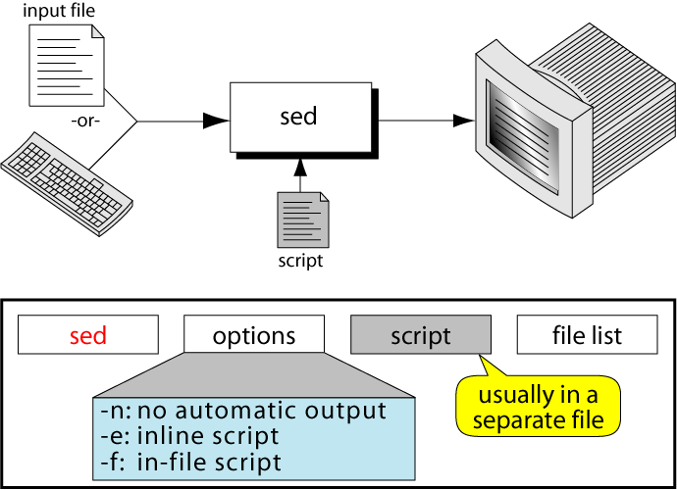
Sed
Sed is one of the most powerful filters. it stands for stream editor. Despite its name editing, it does not modify the original file. It reads the standard input (a keyboard or file), processes it using a separate file called sed script and writes the standard output.

Slide 65
Sed
Options:
-e: it is a default option. It indicates that the script is on the command line.
-f: it indicates that script is in a file which immediately follows this option.
-n: it suppresses the automatic output. That is, it will not display the contents of the pattern space.

Slide 66
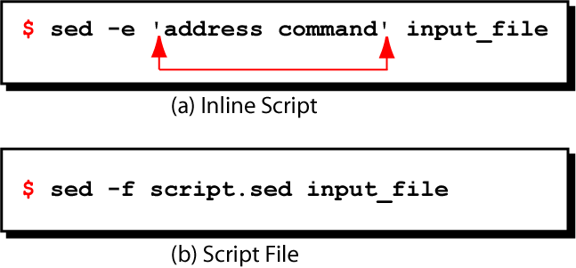
Scripts, Operation
A script is nothing more than a file of commands or instructions.
Each command consists of an address and an action, where the address can be a pattern (regular expression)
address | ! | Action
Complement operator(optional)
A Sed instruction

Slide 67
Scripts
Here is an example of sed script namely sample.sed
Sample.sed
# this is one line comment
#this is another comment
>Sed 3d sample.sed
>sed 1,10s/friends/buddies testfile.txt
In the sample script, the first two line are the comments. The third and fourth lines are the instructions. The former specifies the third line in the input file is to be deleted while the later specifies to replace all occurrences of “friends” by “buddies ” in the input lines 1 through 10.

Slide 68
Examples:
$ cat>file1.txt
unix is great os. unix is opensource. unix is free os.
learn operating system.
unix linux which one you choose.
unix is easy to learn.unix is a multiuser os.Learn unix .unix is a powerful
Example 1: sed ‘s/unix/linux/’ file1.txt (replace only 1st occurance)
Example 2: sed ‘s/unix/linux/g’ file1.txt (replace all occurance)
Example 3: sed ‘3 s/unix/linux/g’ file1.txt (replace specific line occurance)
Example 4: sed ‘2d’ file1.txt (delete 2nd line)
Example 5: sed ‘$d’ file1.txt (delete all line)

Slide 69
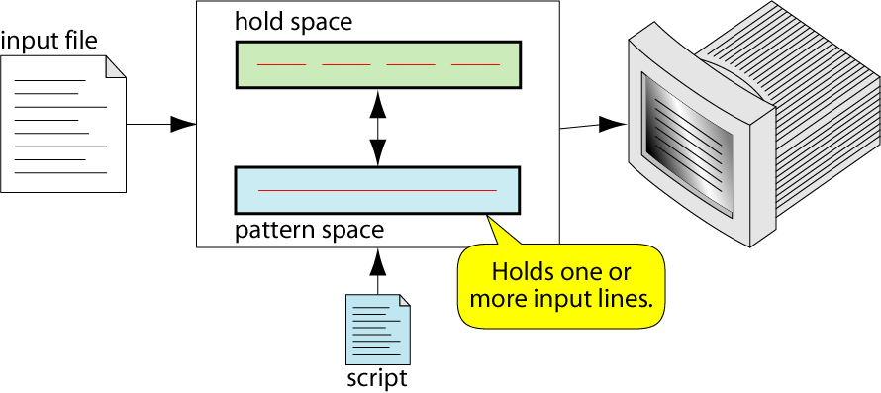
Scripts, Operation
As each line of the input file is read, sed reads the first command of the script and checks the address or pattern against the current input line
If there is a match, the command is executed
If there is no match, the command is ignored

Slide 70
Addresses
Address determines which lines in the input file are to be processed by the command(s)
if no address is specified, then the command is applied to each input line
Address types:
Single-Line address
Set-of-Lines address
Range address
Nested address
Single-Line Address
Specifies only one line in the input file
special: dollar sign ($) denotes last line of input file

Slide 71
Addresses
Examples:
show only line 3
sed -n -e '3 p' input-file
show only last line
sed -n -e '$ p' input-file
substitute ―”endif” with ―”fi” on line 10
sed -e '10 s/endif/fi/' input-file
Set-of-Lines Address
use regular expression to match lines
written between two slashes
process only lines that match
may match several lines
lines may or may not be consecutives
Examples:
/^A/command (Matches all lines that start with ‘A’)
/^$/colmmand (Matches blank lines)

Slide 72
Addresses
Range Address
Defines a set of consecutive lines
Format:
start-addr,end-addr (inclusive)
following are the possible combinations
10,50 line-number,line-number
10,/R.E/ line-number,/RegExp/
/R.E./,10 / RegExp/,line-number
/R.E./,/R.E/ /RegExp/,/RegExp/
Examples :
4,9 (Matches all lines 4 through 9)
2,/^A/command (starts matching from line 2 to a line that starts with A)
/^A/,15 (starts matching from a line that begins with A to 15)
/^A/,/$B/command (starts matching from a line that begins with A to a line that ends with B)

Slide 73
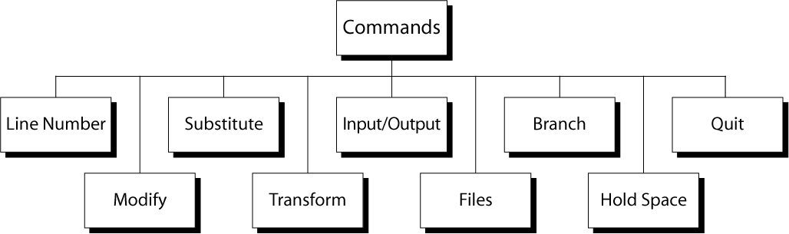
Commands
Line Number
line number command (=) writes the current line number before each matched/output line
Example:
$ sed ‘=‘ twister.dat
This command print the file twister.dat with line number

Slide 74
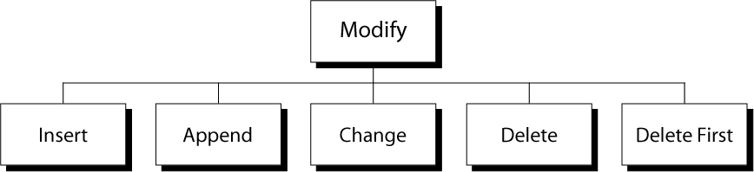
Commands
Insert Command: I
adds one or more lines directly to the output before the address:
inserted “text” never appears in sed‘s pattern space
cannot be used with a range address; can only be used with the single-line and set-of-lines address types
Syntax:
[address] i\
text \

Slide 75
Commands
Append Command: a
adds one or more lines directly to the output after the address:
Similar to the insert command (i), append cannot be used with a range address.
Appended ―text‖ does not appear in sed‘s pattern space.
Syntax:
[address] a\
text
EX:
Script.sed
#script to append the text at the end of the file
$a\
Is it difficult? Try again!

Slide 76
Addresses
Change Command: c
replaces the lines matching the address with x:new text
accepts four address types:
single-line, set-of-line, range, and nested addresses.
Syntax:
[address1[,address2]] c\
text
Ex: $sed –f script.sed twister.dat
Script.sed
5c\
Red Blood Blue Blood\
Deadly Dinosaurs Danced Dizzly
o/p:
Bad Black Bread
Fresh Fried Fish

Slide 77
Commands
Ex: to delete all the lines that starts with a capital letter either B or I
$sed ‘/^[BI]/d’ twister.dat
o/p:
Fresh Fried Fish
Six Thick Thistle Sticks
Short Socks with Spots

Slide 78
Commands
Substitute command:
The substitute command, replaces the text matching the search pattern with a replacement string.
Syntax:
[address(es)]s/pattern/replacement/[flags]
pattern - search pattern
replacement - replacement string for pattern
flags - optionally any of the following
n it replaces only the specified occurrence of pattern
Here n is an integer
g it replaces all occurrences of a pattern in pattern space
By default it replaces the first occurrences of a pattern
p print contents of pattern spac
W it writes a file

Slide 79
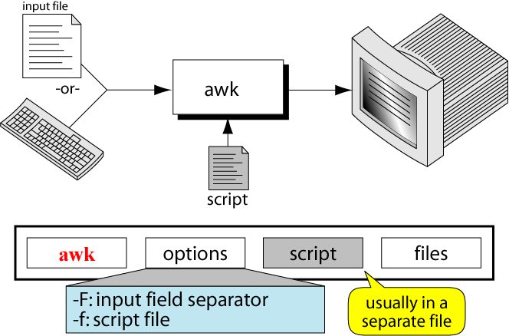
The awk utility, which takes its name from the initials of its authors (Aho, Weinberger, and Kernighan), is a powerful programming language.
Awk

Slide 80
Execution
In addition to input data, awk also requires one or more instructions that provide editing instructions.
A few instructions can be entered at the command line from the keyboard.
Most of the time, the instructions are placed in a file known as an awk script.
Syntax
$awk options awk scripts file(s)
Options
-f: it indicates that script is in a file which immediately follows this option.
-F:this option specifies the input field seperator. By default, it is space or a tab.

Slide 81
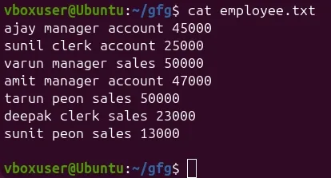
AWK Examples:
$cat>employee.txt
$awk '{print}' employee.txt (Print All Lines)
$awk '{print $1,$4}' employee.txt(Print Specific Columns)
$awk '{print NR,$0}' employee.txt(Display Line Number)
$awk '/manager/ {print}' employee.txt(Search Lines with a Keyword)
$awk -F' ' '{print $1, $4}' employee.txt(sets a custom field separator)
$nano print_sal.awk → { print $1, "has salary", $4 }
$awk -f print_salary.awk employee.txt
$awk -v limit=40000 '$4 > limit {print $1, $4}' employee.txt

Slide 82
Fields and Records
The awk utility views a file as a collection of fields and records.
A field is a unit of data that has informational content.
Each field of information is separated by one or more whitespace characters or other separator.
Each line is a record. A record is a collection of fields.
When a file is organized into records, we call it a data file, as contrasted with a text file.
awk also can handle a text file.

Slide 83
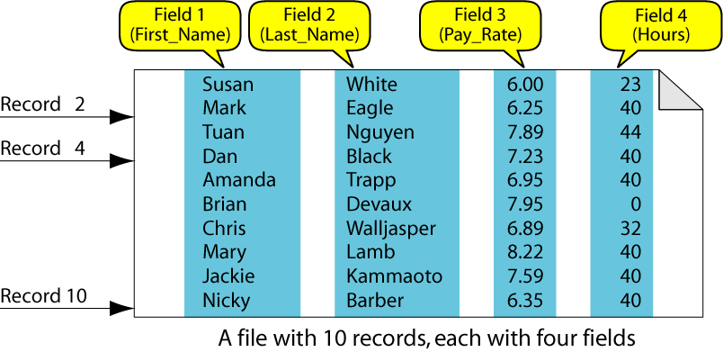
A Data File

Slide 84
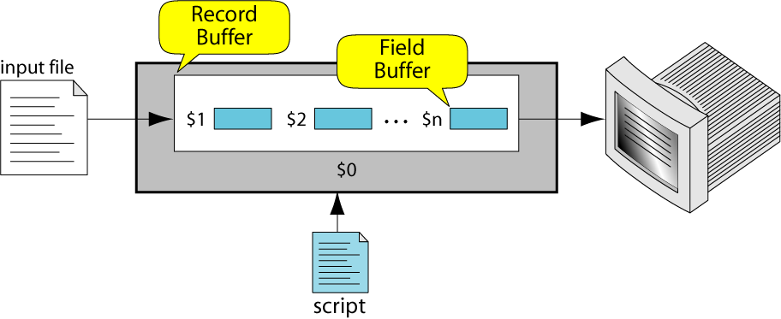
Field Buffers
There are as many field buffers available as there are fields in the current record of the input file.
Each buffer has a name, which is the dollar sign $ followed by the field number in the current record.

Slide 85
Record Buffer
There is only one record buffer available. Its name is $0.
It holds the whole record.

Slide 86
System Variables
FS Input field separator
RS Input record separator
OFS Output field separator
ORS Output record separator
NF Number of nonempty fields in a record
NR Number of records read from all files
FNR Number of records in current file
FILENAME Name of the current file

Slide 87
System Variables
Examples :
% cat emps
Tom Jones 4424 5/12/66 543354
Mary Adams 5346 11/4/63 28765
Sally Chang 1654 7/22/54 650000
Billy Black 1683 9/23/44 336500
% awk '{print NR, $0}' emps
1 Tom Jones 4424 5/12/66 543354
2 Mary Adams 5346 11/4/63 28765
3 Sally Chang 1654 7/22/54 650000
4 Billy Black 1683 9/23/44 336500

Slide 88
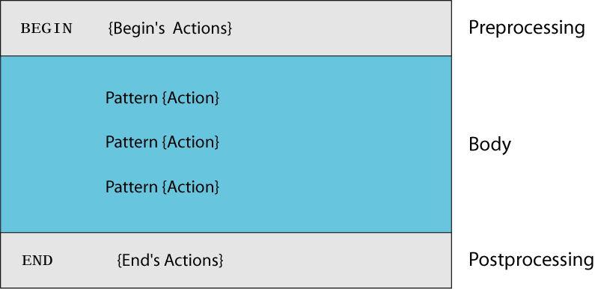
awk Script Design

Slide 89
Recursive representation of Factorial(4)
awk Script
BEGIN: pre-processing
performs processing that must be completed before the file processing starts (i.e., before awk starts reading records from the input file)
useful for initialization tasks such as to initialize variables and to create report headings
BODY: Processing
contains main processing logic to be applied to input records
like a loop that processes input data one record at a time:
if a file contains 100 records, the body will be executed 100 times, one for each record

Slide 90
awk Script
END: post-processing
contains logic to be executed after all input data have been processed
logic such as printing report grand total should be performed in this part of the script

Slide 91
Operations
The awk utility reads an input file, line by line and applies all the instructions in awk script to each input line. It does not print the lines unless the print action is specified .consider a records .dat with five fields i.e,s.no,name,test1,test2,test3 and four records.
1 A 75 81 89
2 B 86 94 82
3 C 90 71 96
4 D 82 70 85
$awk –f total.awk records.dat
Total.awk
#initialization section
BEGIN {print “name\t total”}

Slide 92
Operations
#body section
{total=$3+$4+$5}
{print $2+”\t” total}
#END of job
END {print “Best Result”}
Output:
Name total
A 245
B 262
C 257
D 237
Best Result

Slide 93
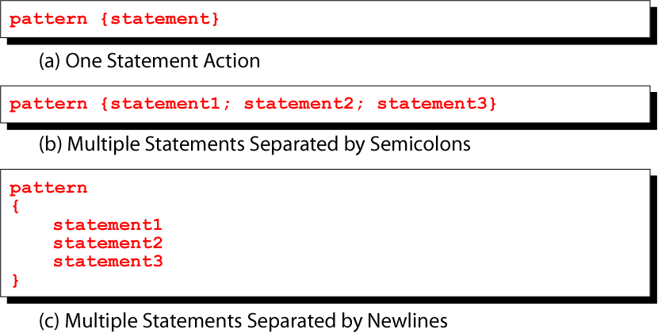
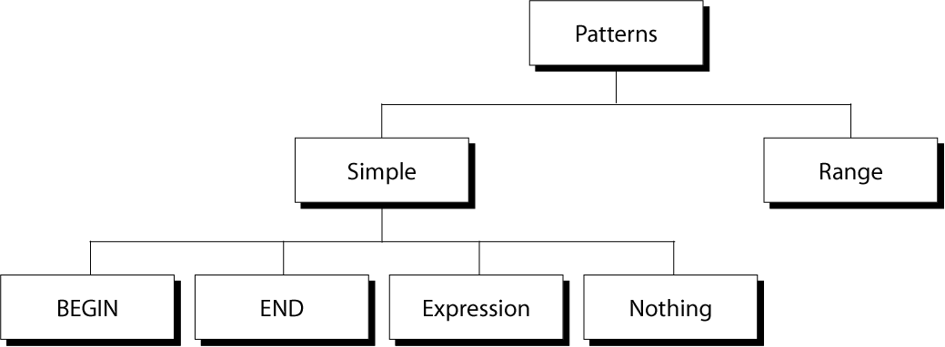
Pattern/Action

Slide 94
Expression Pattern types
match
entire input record
regular expression enclosed by ‘/’s
explicit pattern-matching expressions
~ (match), !~ (not match)
expression operators
arithmetic
relational
logical

Slide 95
Example: match input record
% cat employees2
Tom Jones:4424:5/12/66:543354
Mary Adams:5346:11/4/63:28765
Sally Chang:1654:7/22/54:650000
Billy Black:1683:9/23/44:336500
% awk –F: '/00$/' employees2
Sally Chang:1654:7/22/54:650000
Billy Black:1683:9/23/44:336500

Slide 96
Arithmetic Operators
Operator Meaning Example
+ Add x + y
- Subtract x – y
* Multiply x * y
/ Divide x / y
% Modulus x % y
^ Exponential x ^ y
Example:
% awk '$3 * $4 > 500 {print $0}' file

Slide 97
Relational Operators
Operator Meaning Example
< Less than x < y
< = Less than or equal x < = y
== Equal to x == y
!= Not equal to x != y
> Greater than x > y
> = Greater than or equal to x > = y
~ Matched by reg exp x ~ /y/
!~ Not matched by req exp x !~ /y/

Slide 98
Logical Operators
Operator Meaning Example
&& Logical AND a && b
|| Logical OR a || b
! NOT ! a
Examples:
% awk '($2 > 5) && ($2 <= 15)
{print $0}' file
% awk '$3 == 100 || $4 > 50' file

Slide 99
Logical Operators
Operator Meaning Example
&& Logical AND a && b
|| Logical OR a || b
! NOT ! a
Examples:
% awk '($2 > 5) && ($2 <= 15)
{print $0}' file
% awk '$3 == 100 || $4 > 50' file

Slide 100
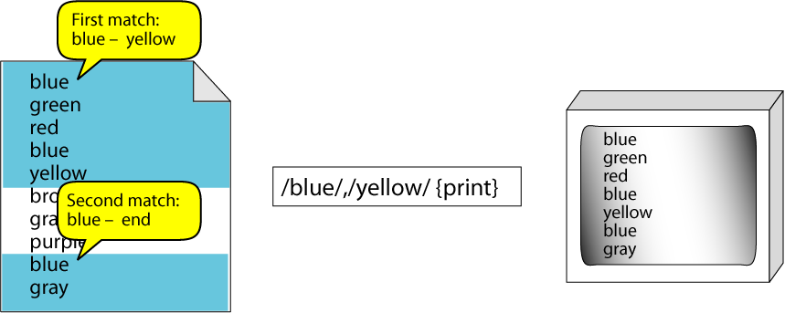
Range Patterns
Matches ranges of consecutive input lines
Syntax:
pattern1 , pattern2 {action}
pattern can be any simple pattern
pattern1 turns action on
pattern2 turns action off
Example:

Slide 101
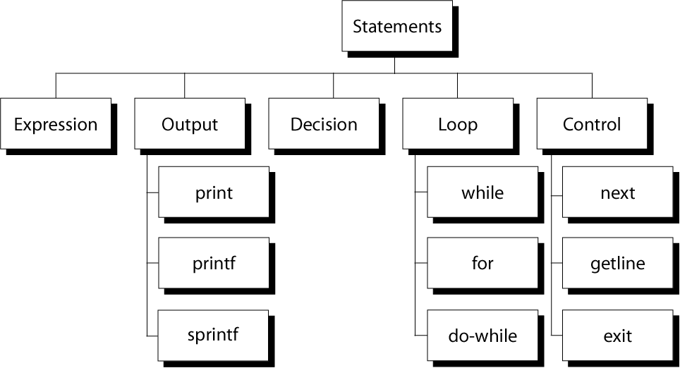
awk Actions
The first job of a preprocessor is file inclusion - the copying of one or more files into programs.
The files are usually header files consisting declarations of predefined functions and external files containing functions and data declarations.
General form is,
#include filename
It has two different forms
1. #include <filename>
2. #include “filename”

Slide 102
awk expressions
Expression is evaluated and returns value
consists of any combination of numeric and string constants, variables, operators, functions, and regular expressions
Can involve variables
As part of expression evaluation
As target of assignment

Slide 103
awk variables
A user can define any number of variables within an awk script
The variables can be numbers, strings, or arrays
Variable names start with a letter, followed by letters, digits, and underscore
Variables come into existence the first time they are referenced; therefore, they do not need to be declared before use
All variables are initially created as strings and initialized to a null string “”
Format:
variable = expression
Examples:
% awk '$1 ~ /Tom/
{wage = $3 * $4; print wage}'
filename
% awk '$4 == "CA"
{$4 = "California"; print $0}'
filename

Slide 104
awk assignment operators
= assign result of right-hand-side expression to
left-hand-side variable
++ Add 1 to variable
-- Subtract 1 from variable
+= Assign result of addition
-= Assign result of subtraction
*= Assign result of multiplication
/= Assign result of division
%= Assign result of modulo
^= Assign result of exponentiation

Slide 105
Output Statements
print
print easy and simple output
printf
print formatted (similar to C printf)
sprintf
format string (similar to C sprintf)

Slide 106
Awk control structures
Conditional
if-else
Repetition
for
with counter
with array index
while
do-while
also: break, continue

Slide 107
if Statement
Syntax:
if (conditional expression)
statement-1
else
statement-2
Example:
if ( NR < 3 )
print $2
else
print $3

Slide 108
for Loop
Syntax:
for (initialization; limit-test; update)
statement
Example:
for (i = 1; i <= NR; i++)
{
total += $i
count++
}
For loop for arrays
Syntax:
for (var in array)
statement
Example:
for (x in deptSales)
{
print x, deptSales[x] }

Slide 109
while Loop
Syntax:
while (logical expression)
statement
Example:
i = 1
while (i <= NF)
{
print i, $i
i++
}

Slide 110
do-while Loop
Syntax:
do
statement
while (condition)
statement is executed at least once, even if condition is false at the beginning
Example:
i = 1
do {
print $0
i++
} while (i <= 10)

